Slide 1
Animal Fries
Final Presentation
Alice, Andrew, Kimiko, Shreeman, Siyuan, Won

Slide 2
how might we
redesign
the classroom experience?

Slide 3
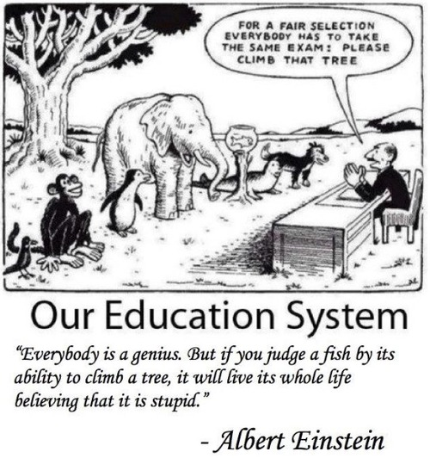
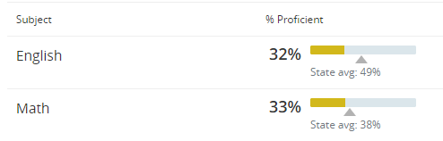
design challenge
Notes:
Shreeman

Slide 4
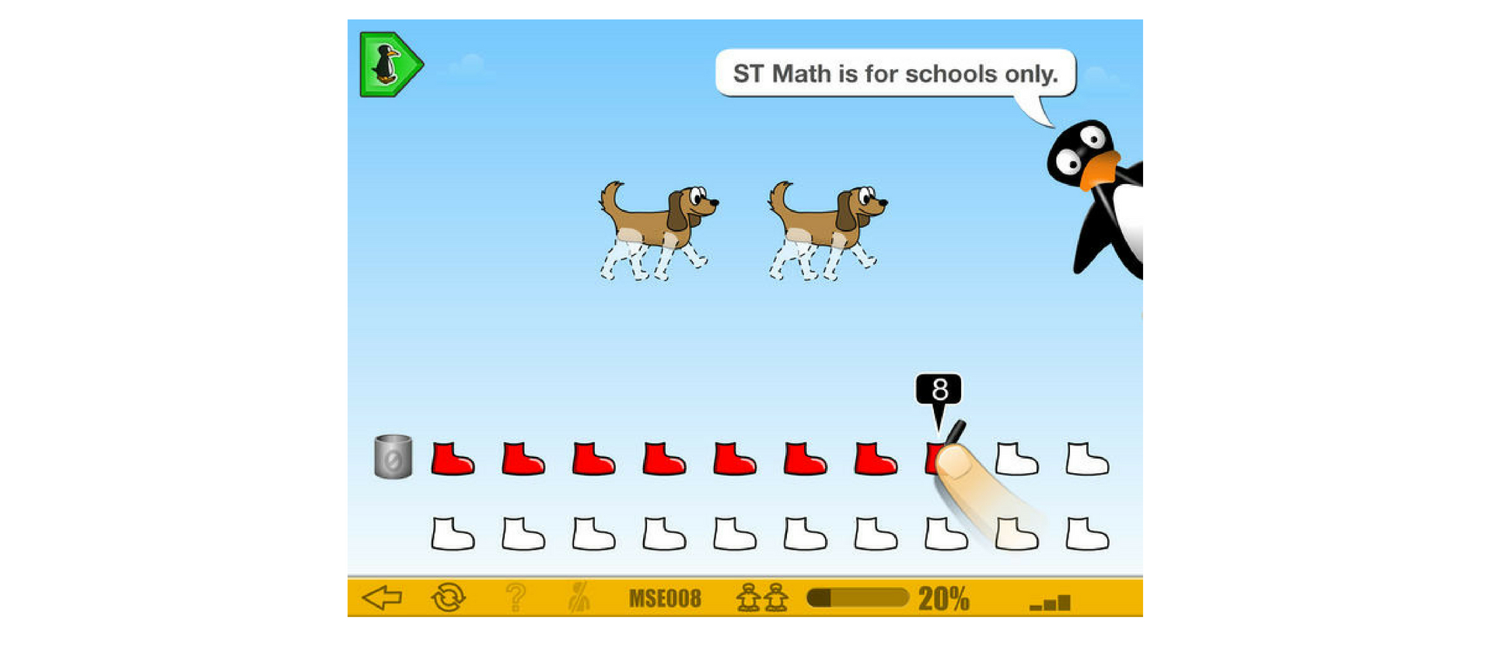
Notes:
Won

Slide 5
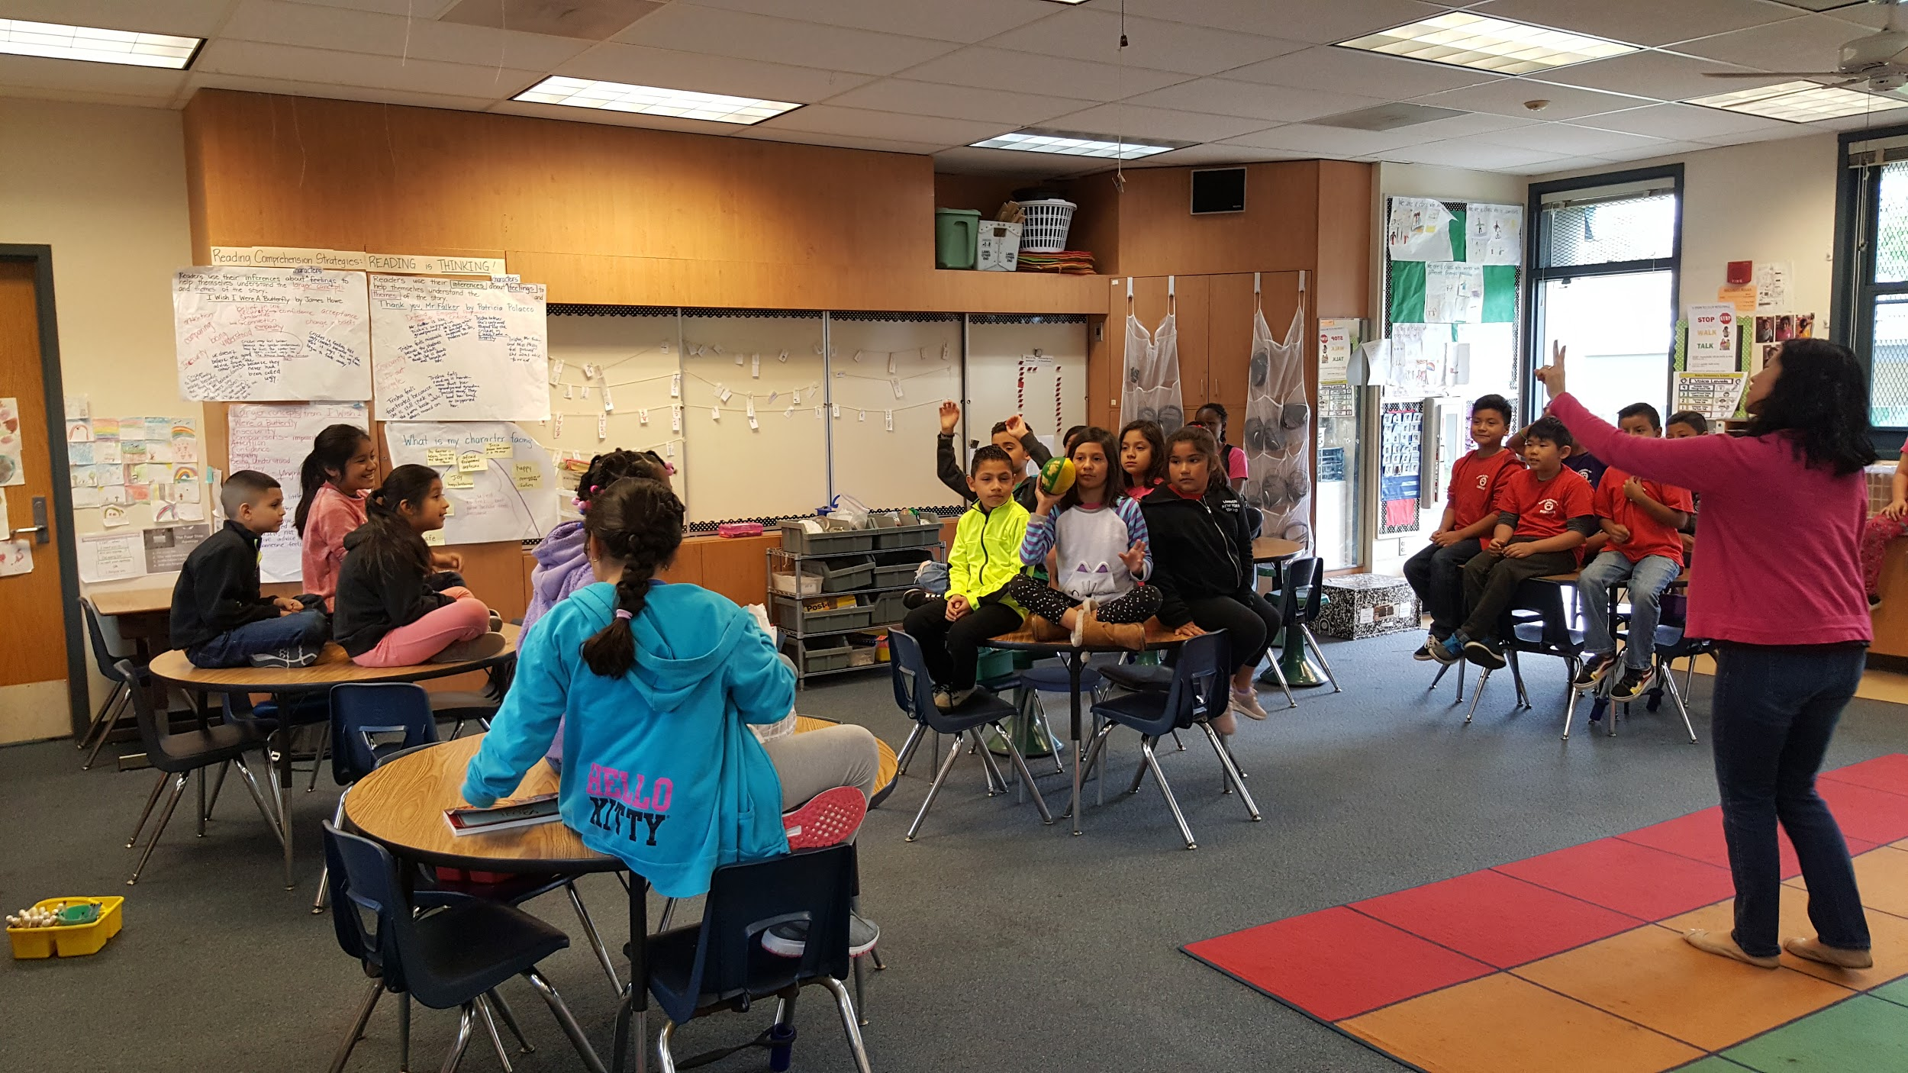
key stakeholders
Mrs. Han
Mrs. Han’s students
Notes:
Alice

Slide 6
interviews
“I like being creative”
“I wish we had more art”
“I like hands-on activities”
Notes:
Siyuan

Slide 7
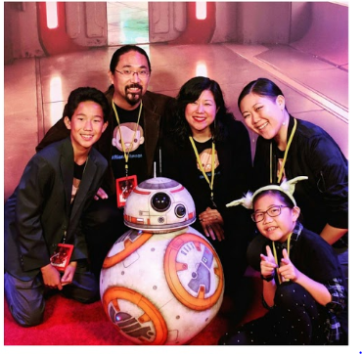
interviews
“I don’t know a lot about art”
“I have little funding for art”
“I wish I could do more for my students”
Notes:
Siyuan

Slide 8
problem statement
Mrs. Han’s class needs more access to exemplary art and interdisciplinary curriculum alongside STEM because students should have the resources to explore their unique interests and strengths.
Notes:
Siyuan

Slide 9
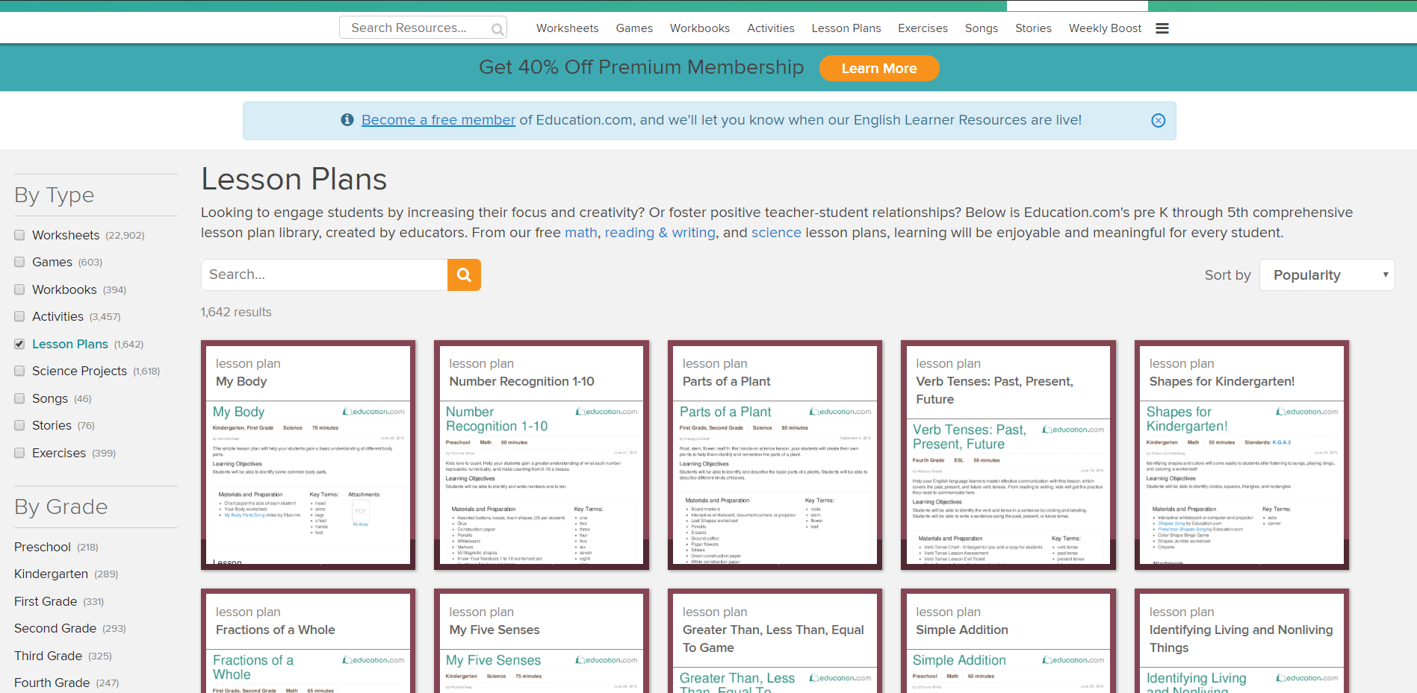
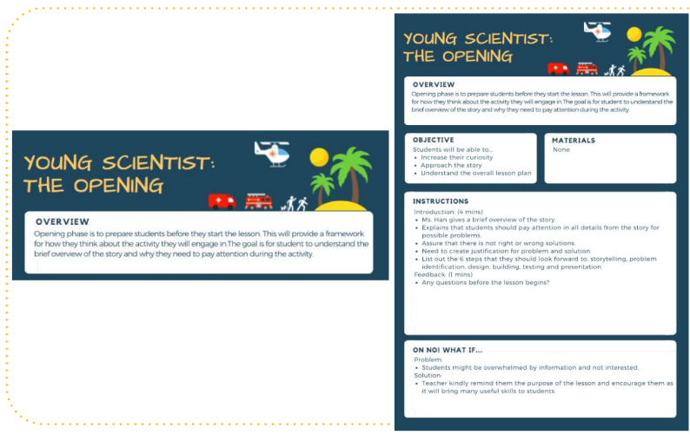

competitive analysis
Education.com
Team Baker - ENG 100D, Winter 2018
sciencebuddies.org

Slide 10
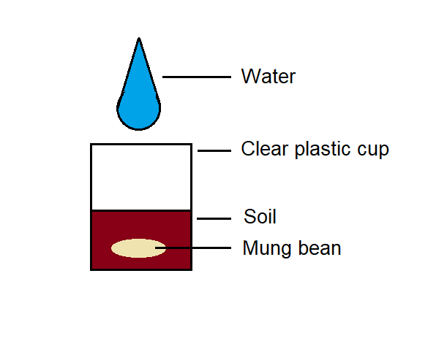
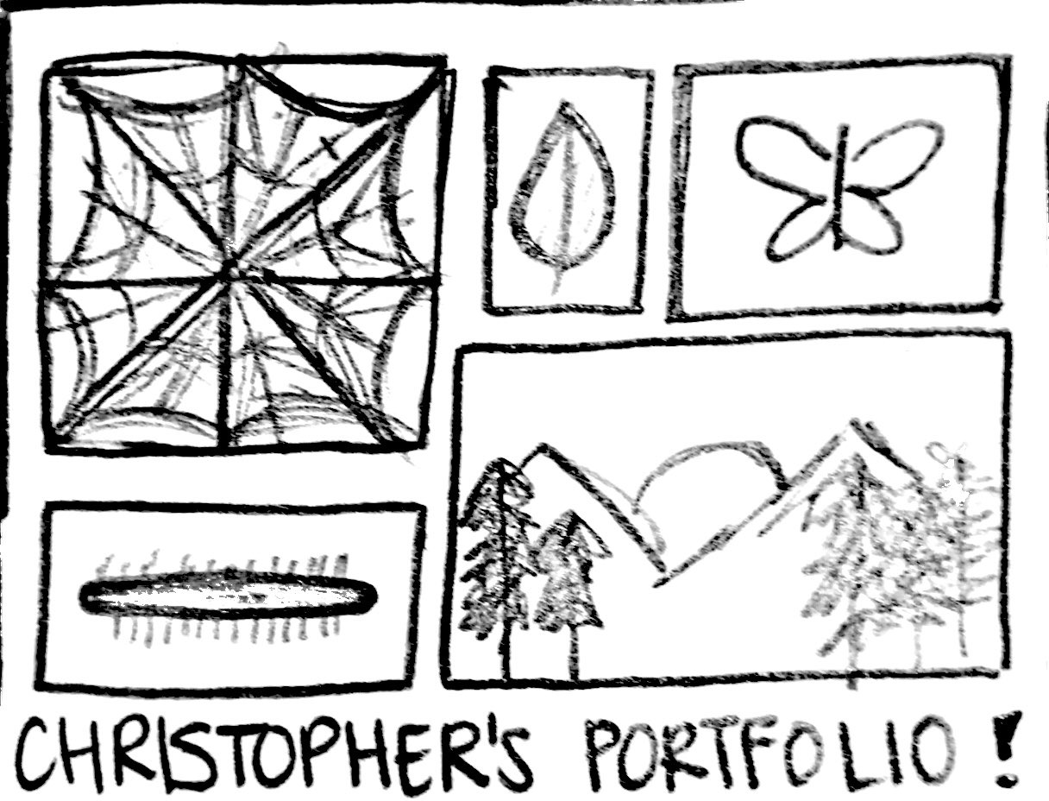
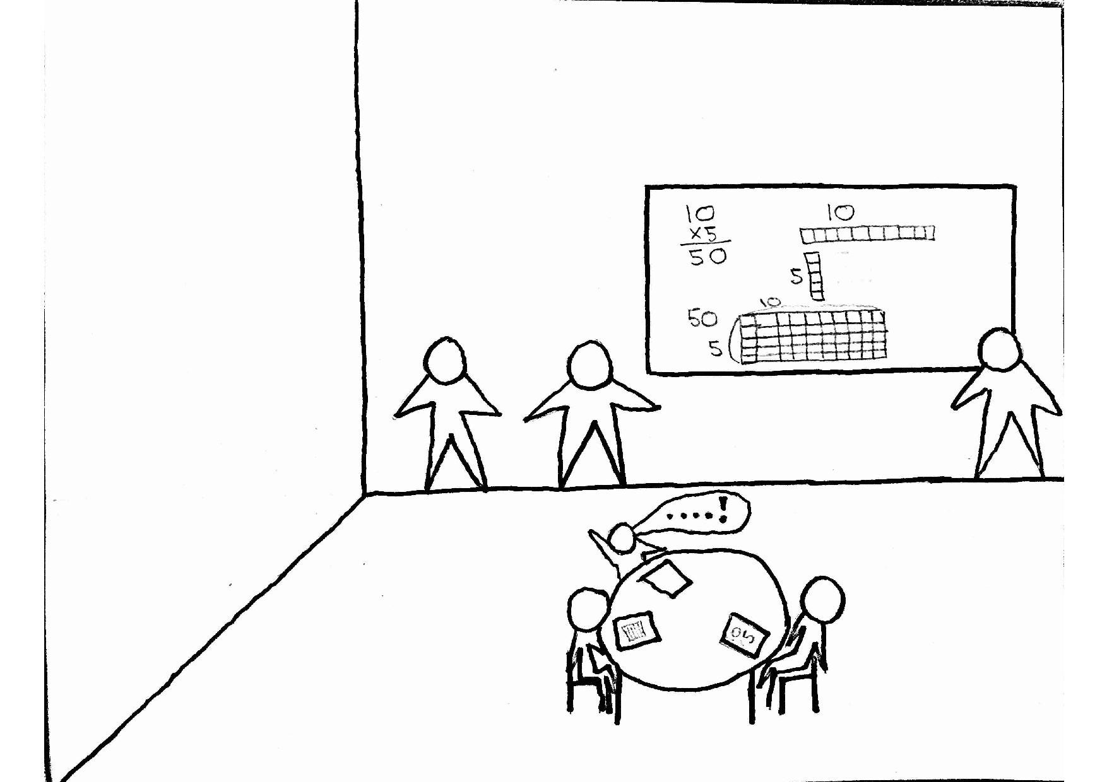
concept generation
Mung Bean Growth Journal=+6
Art Portfolio=+7
Students Teach the Class=+0
Results from decision matrix indicate art portfolio as best
Notes:
Shreeman

Slide 11
user testing: round 1

Slide 12
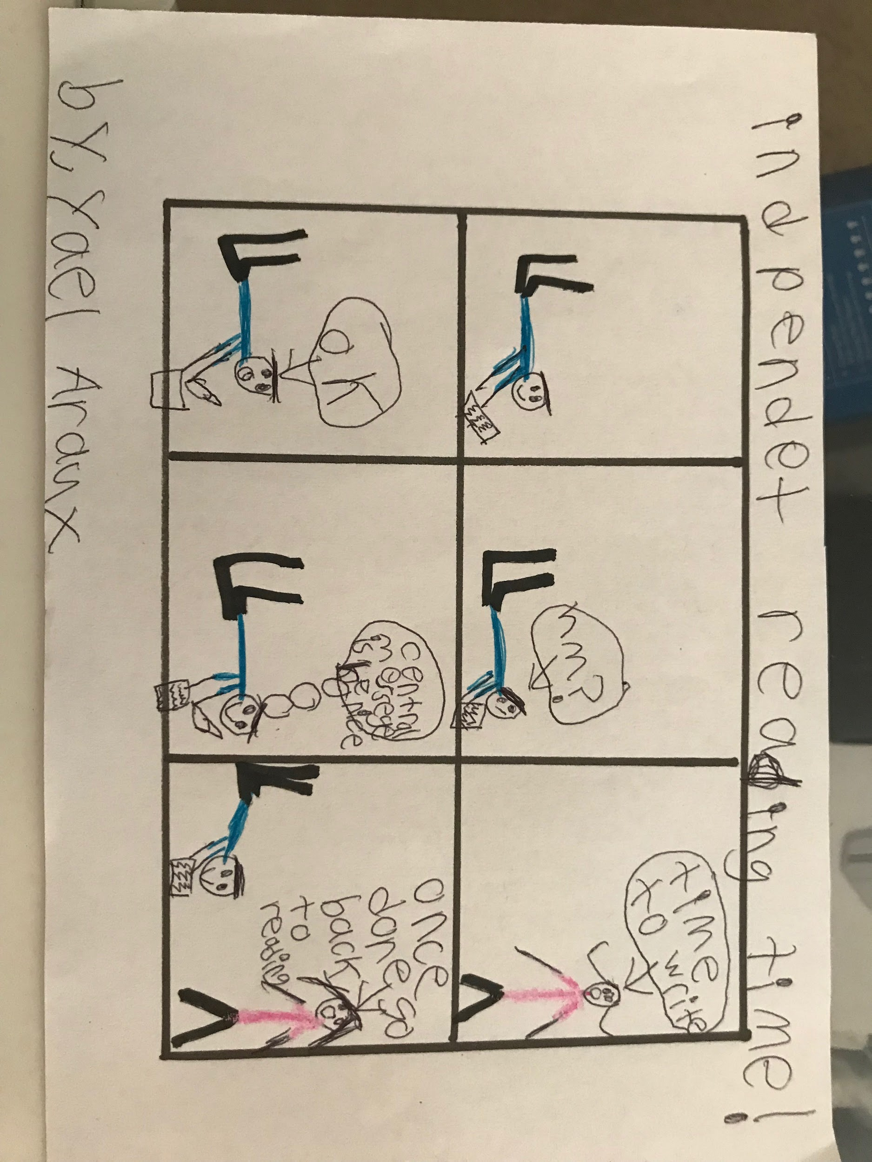
art lesson plans
Notes:
** Make sure to include how our final idea evolved

Slide 13
testing results:
Students were too easily distracted
Find balance between simplicity + challenge
For sustainability and feasibility, we narrowed it down to the Comic Book activity and focused on writing.
Notes:
ANDREW - tackling to many things at once
Like won mentioned, they already have other resources for math -ST Math

Slide 14
redefining problem statement:
Mrs. Han’s class needs a creative art curriculum for the students to practice their English writing with, because the 3rd grade students at Baker Elementary have been underperforming in their standardized testing.
Notes:
ANDREW - Focus on practicing English

Slide 15
user testing: round 2

Slide 16
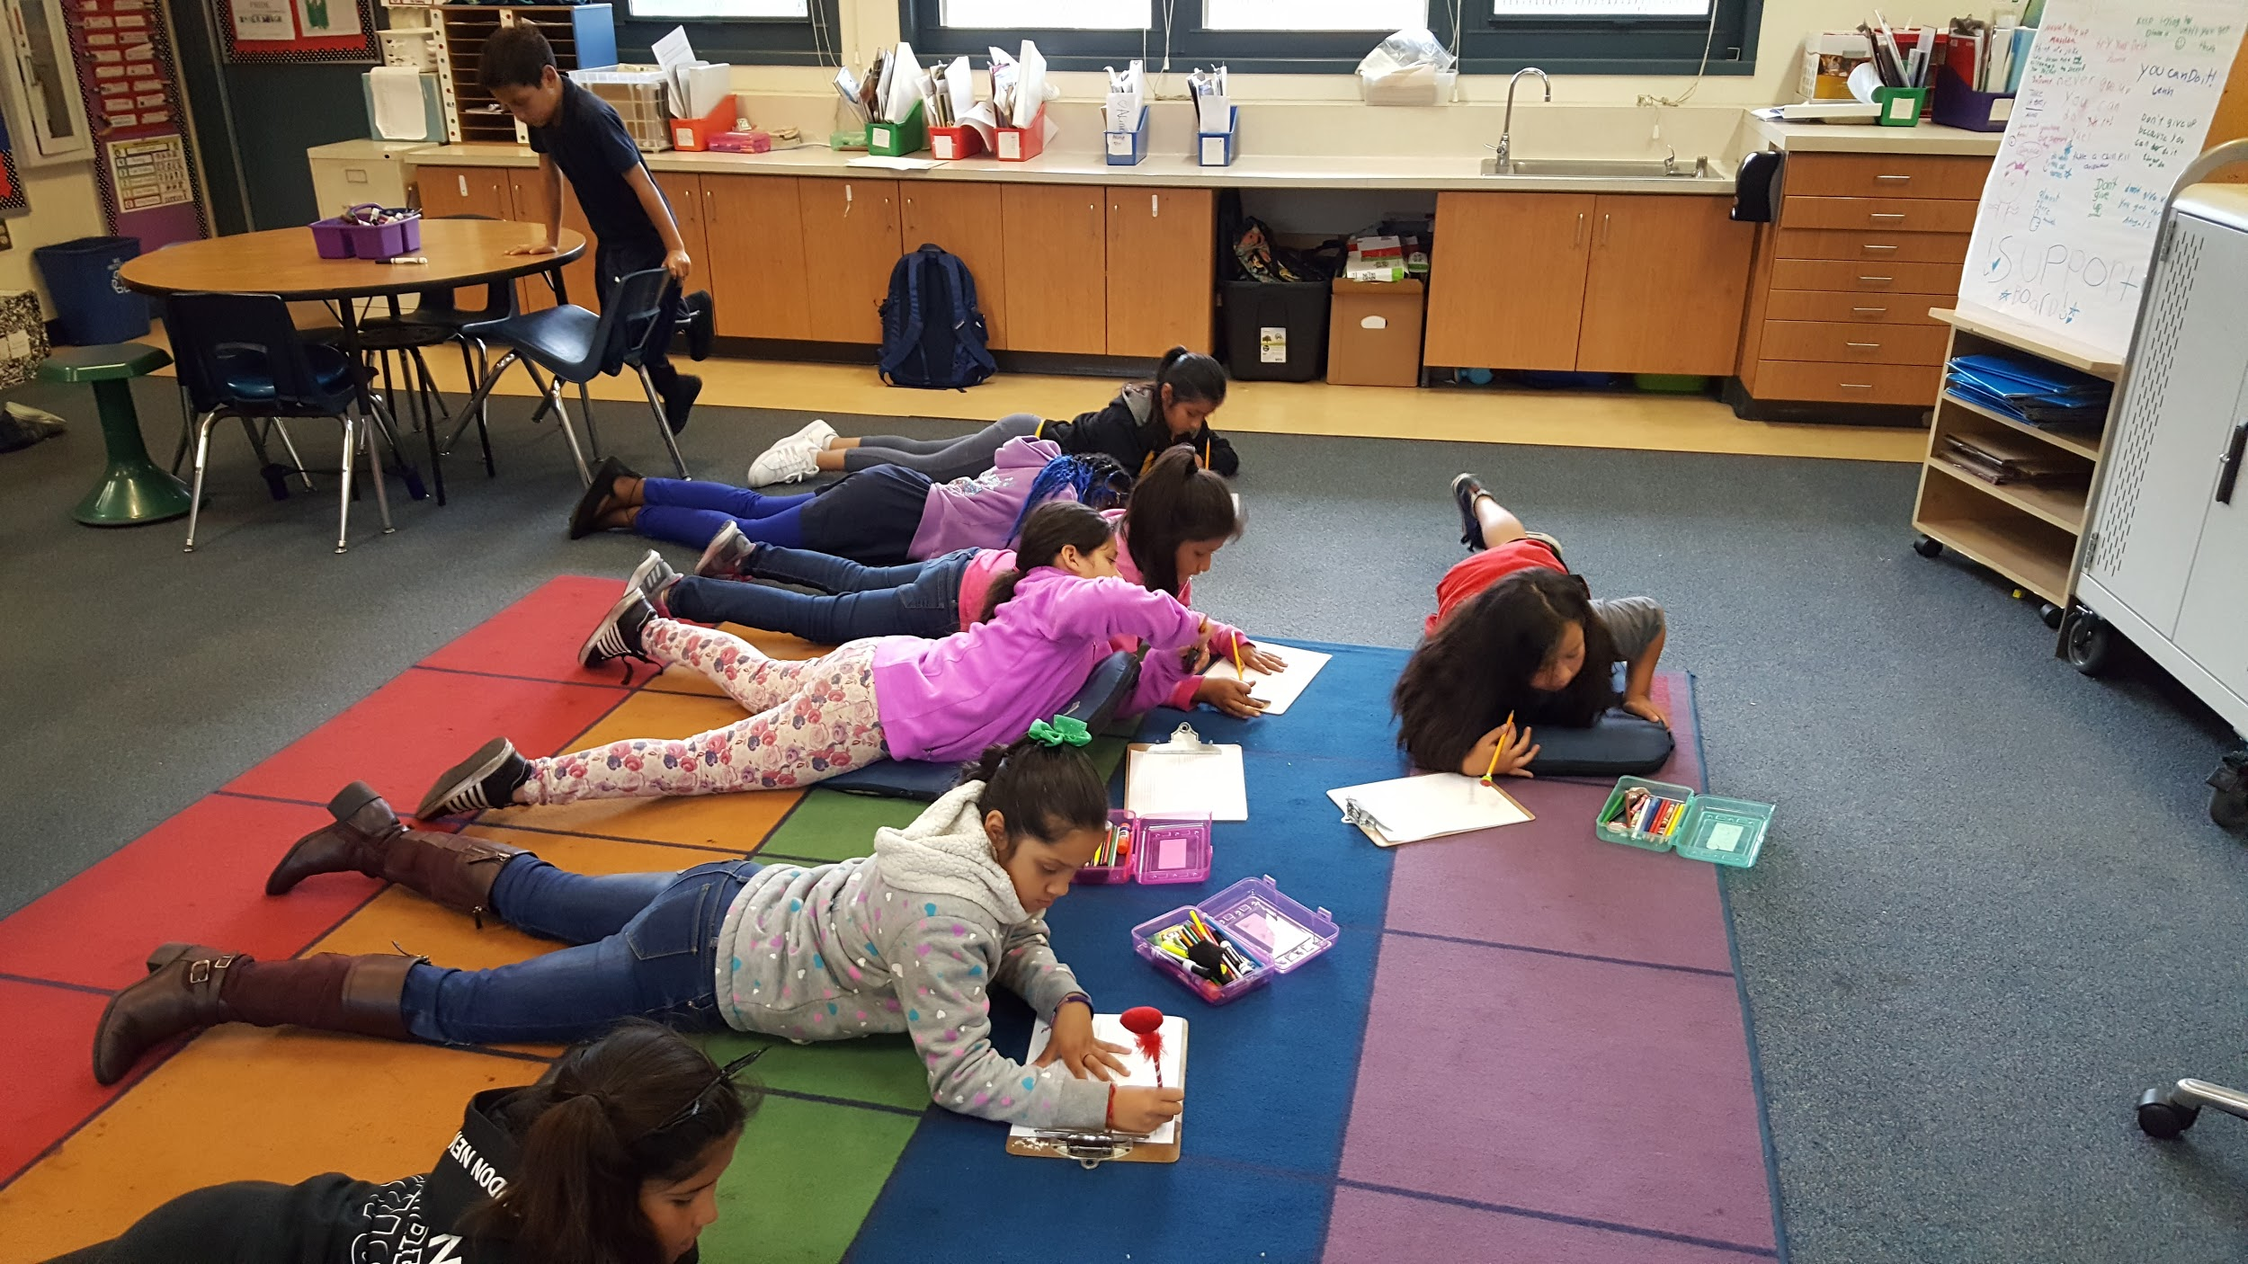
comic strips w/ text lines
Allows students to practice their writing
Silent work time
Mrs. Han leads the activity while we observe
Notes:
Alice
Changed the format of the comic panels by adding text lines under each of the six boxes
Incorporated Silent Work time to help with the students getting too distracted while they were working
Asked Mrs. Han to lead the activity in order to see how the students would respond differently depending on who was leading the lesson
She had the idea to change the prompt for the students
We originally asked them to just draw about anything they learned in class
Mrs. Han framed it as them trying to teach an incoming 3rd grader

Slide 17
testing results:
Pro - Allowing students to showcase their art to each other
Con - Not enough directions/guidance
Notes:
Alice
A pro from this round was that Mrs. Han asked the students to show their art to each other which got them excited and engaged
However, a couple of cons we noticed that there were some students who weren’t sure exactly what to draw and they ended up sitting there with blank pages
Other students decided that they only wanted to focus on their drawings and not write, while others focused on just writing and not on the drawing portions.

Slide 18
stakeholder feedback

Slide 19
final feedback
Had trouble fitting their drawings in smaller boxes
Avoiding popularity contest
Co-Design process

Slide 20
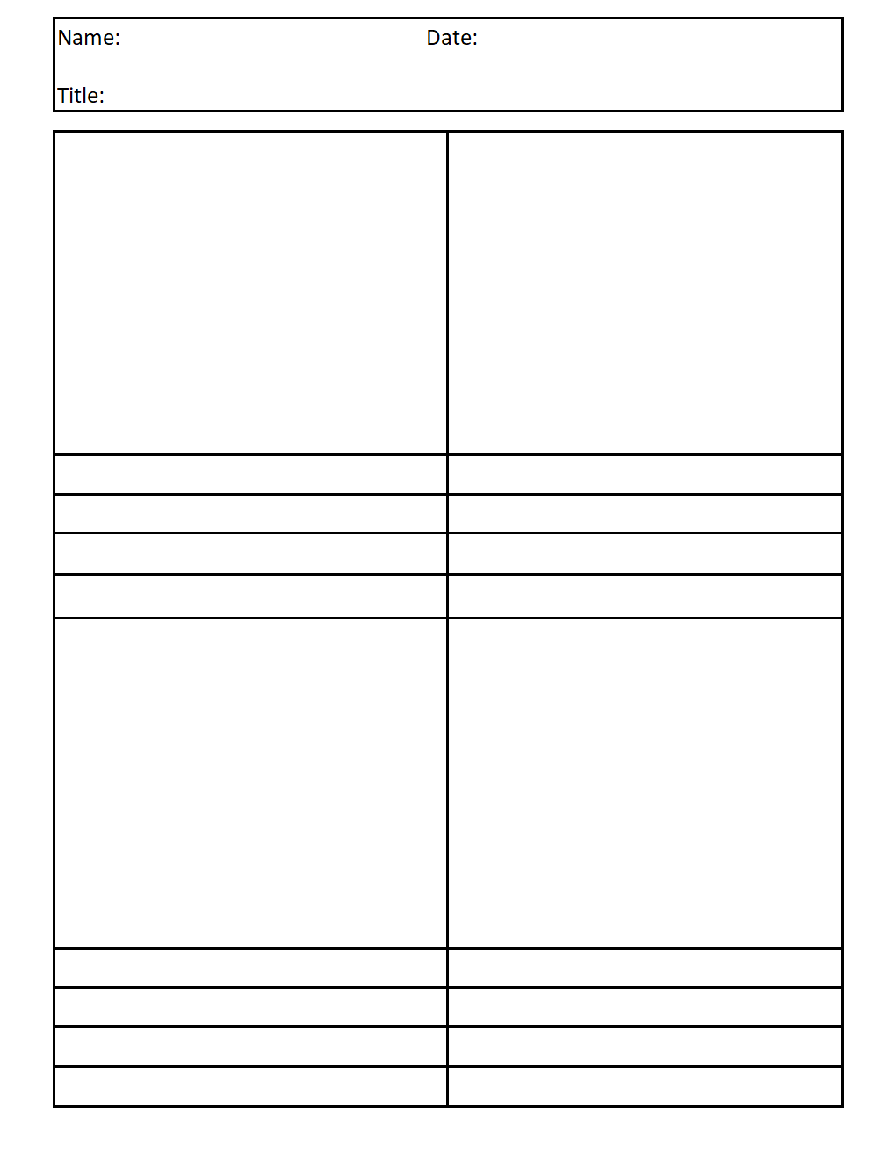
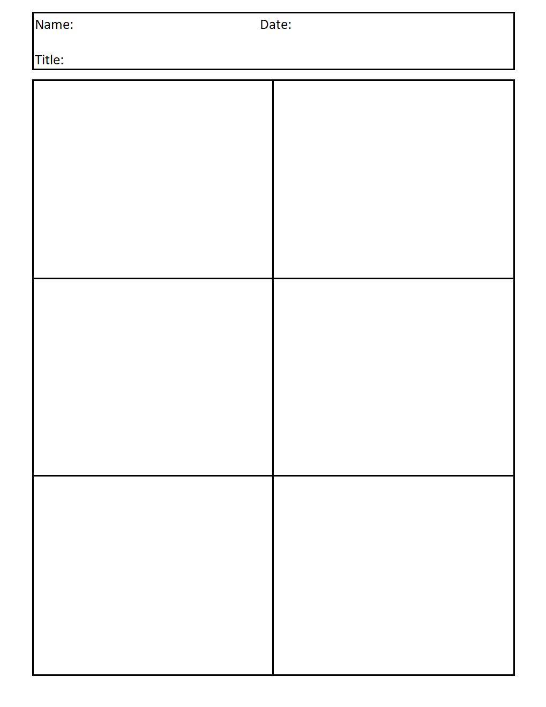
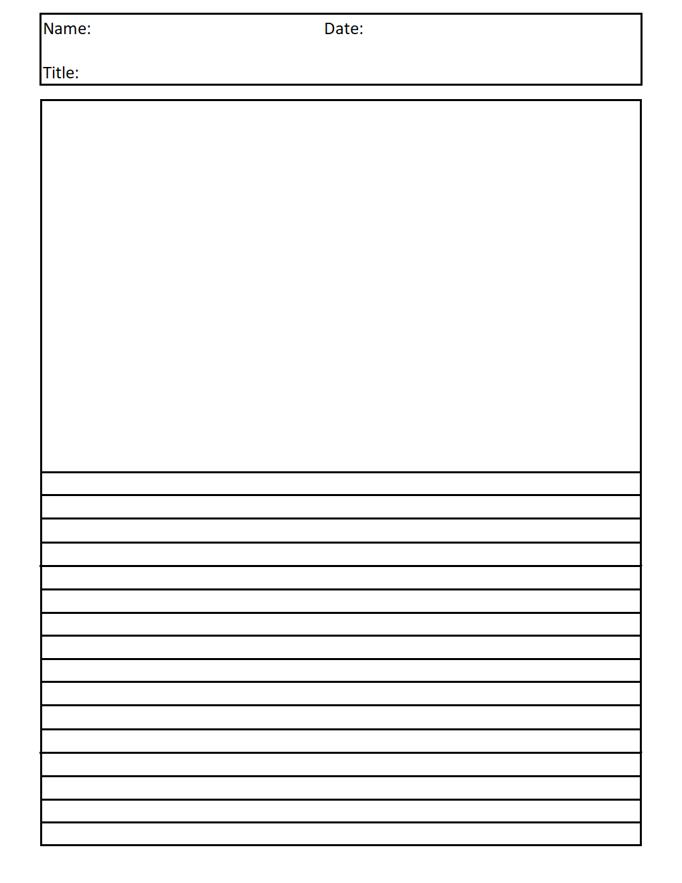
final solution: 3rd grade survival guide
Template 1
Template 2
Template 3
Notes:
Kimiko
based on final feedback, we designed three templates
first: standard comic strip
second: appeals towards students who enjoy drawing
third: appeals towards students who enjoy writing

Slide 21
in the future
Notes:
WON

Slide 22
implementation
Lesson plan + templates accessible electronically
Can perform comic strip activity once a week or at Mrs. Han’s discretion
Notes:
kimiko

Slide 23
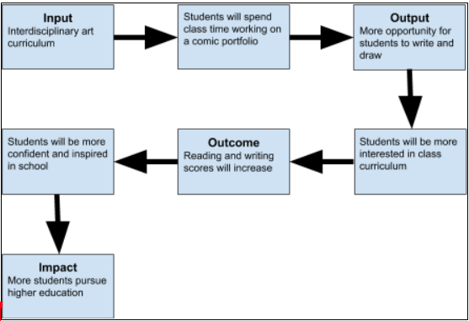
impact
Notes:
WON:
Root problem is lack of funding - we got around the issue
Not a first order change
Measures of success - quantity of entries, test scores

Slide 24
Thank you!
Any questions?
Notes:
EVERYONE

